Slide 1
Project on Sustainability: Energy Mapping of an area & GHG Emission Calculation Guide
Ananya Singh
IIT Delhi
Mentors :
Dilan Appachu : Assistant Manager EHS
Kavitha Shanmugam : Global Sustainability Manager

Slide 2
Objectives of the project
Energy Mapping is an important tool to provide valuable insights into energy usage, which is essential to analyze energy usage data to identify areas for improvement. By visualizing energy at a granular level, industries can align with sustainability goals , streamline the process and minimize resource consumption.
The two main objects of our project are:
Developing a standardized manual/handbook to enhance the data collection process for estimating Greenhouse Gas emissions: A Case Study of the Peenya plant.
Examining the current energy consumption data and technologies to identify gaps within the processes. – CASE STUDY OF SMALL CYLINDER PLANT IN PEENYA.
Notes:
We all know how important energy mapping is to give us insights on the energy usage. It helps us realize sustainability goals and minimize resource consumption.

Slide 3

GHG Emissions
For Scopes 1, 2 and 3 i.e. the ways of classifying greenhouse gas emissions, we need to collect data associated with them.
Globally recognized standards, spanning 116 pages, served as the foundation for crafting a concise 14-page guide to streamline and facilitate the data collection process for Greenhouse gas emission calculation.
The handbook entails all the details such as what all data is required for the calculation of emissions, method of data collection, who collects the data and the ideal frequency of collection of data (i.e., once in a month for all categories)
Notes:
GHG Emission or greenhouse gas emissions are divided into 3 categories. Scope 1 has 3 categories, Scope 2 has 1 category and Scope 3 has 15 categories.
We created a 14 page long guide from a 116 page long standard protocol to facilitate the process of data collection.

Slide 4
Efficiency of current data collection process in Peenya plant :
75% accuracy approximately
This is because most of the categories use average data. The accuracy can be increased if supplier specific method is used for calculations.
Project Deliverables : GHG Emission Calculation Guide
The final report for GHG Data Inventory is readily available for any emerging industry, encompassing hydraulics engineering and beyond, given the pressing need for greenhouse gas emission calculations across all sectors.
Notes:
Supplier specific, Hybrid, Spend based, average, lessor specific
This marks the end of part one of our project.

Slide 5
Proposed Energy Mapping Model
Source: Bureau of Energy Efficiency, Government of India
beeindia.gov.in/sites/default/files/1Ch3.pdf
Energy mapping model
Comparison Between 2019-20 Audit Report And The Proposed Energy Model
Energy utilization
Energy usage
Energy input
Cycle Time
Specific Energy Consumption
Power quality and distribution
Energy intensity ☒
Operational hours ☑
Source of Energy ☑
Production cycle time ☒
Per unit of production ☒
Voltage stability ☑
Load profile ☒
Standby and Idle time ☒
Supply reliability ☒
Energy consumption per cycle time ☒
Benchmarking ☒
Power factor ☑
Process efficiency ☒
Equipment specific energy consumption ☒
Energy mix ☑
Distribution losses ☑
Efficiency of cycle time ☒
The energy audit conducted for FY 2019-20 focused on different parameters, and this energy model (through extensive research) has expanded to include a more comprehensive range of metrics.

Slide 6
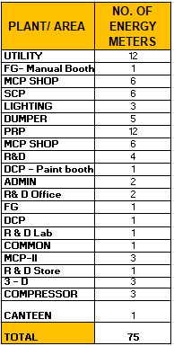
CASE STUDY : PEENYA PLANT
Energy meters in Peenya Plant
There are 75 energy meters in Peenya Plant with maximum meters installed in Piston Rod Plant (PRP) and Utility (Transformer, DG Room etc.) i.e. 12 each.
Current frequency of data collection from the energy meters: Monthly
All areas within the plant are equipped with energy meters to record monthly energy consumption.
The data collection from the energy meters in the plant is based on the area of operation.
Places with maximum energy consumption in Peenya plant are PRP and SCP.
Notes:
If you look at the table you can see both PRP and UTILITY have highest number of energy meters i.e. 12
All the energy meters record the monthly energy consumption readings.

Slide 7
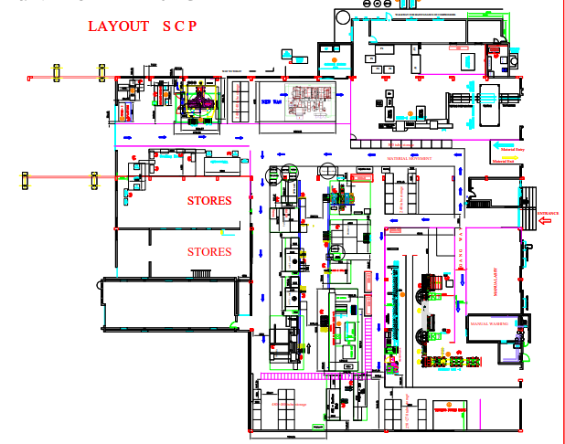
Case Study : Small Cylinder Plant (SCP)
We have chosen to study the patterns of energy consumption in SCP.
Layout of Small Cylinder Plant
Notes:
This brings us to the case study of SCP which as mentioned previously is one of places with maximum energy consumption.

Slide 8
List of Machines in SCP with the Energy meters
Energy Meter - 4
Energy Meter - 1
Energy Meter - 6
Testing Power Pack
Sierra Skimming and Burnishing Machine
ACE – Backhoe(Big)
BOPT Charging Station
Seal Kitting (Stores)
Marking
Grinding
Tube Washing Machine – CLEAN TECH 3
Manual Assembly
Manual Washing
Trunion Line
Primo – II
ACE – 3
SRV component washing machine
Energy Meter - 2
AHU
ACE -1 small
ACE -2 small
Safe Weld
Ultrasonic Washing Machine
FANUC ROBO (Welding machine)
AMS-2 Drilling
Energy Meter - 5
Primo – I
SPM Weld
Store Corrosal
WIDMA
Lathe and cutting machines
M2 Welding Manipulator
Steering PDB
Line-1 Washing (Cleaning station)
EOT Crane, Air Compressor
Energy Meter – 3
Hydraulic Power Pack
Line – I Assembly, Testing

Slide 9
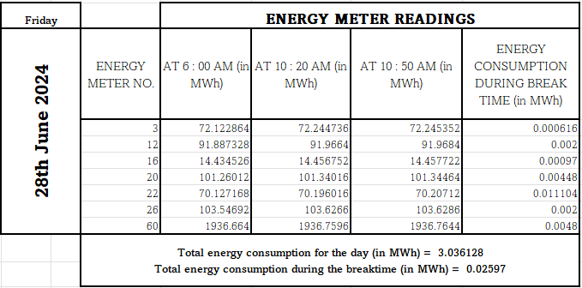
Monitoring the Energy Consumption
Monitoring the breaktime energy consumption (during the general shift) and total energy consumption in the Small Cylinder Plant (SCP). Based on the number of hydraulic cylinders produced per day in the SCP, calculated the energy consumption per hydraulic cylinder.
Recorded the data for energy consumption for 8 days.
The data was recorded in the following way :

Slide 10
Energy consumed (kWh) per hydraulic cylinder per Energy Meter
NOTE : Readings not taken for total energy consumption for 1st and 2nd July.
Energy Meter – 3 is connected to hydraulic power pack. Hydraulic filtration runs non-stop, to ensure constant purification of fluids (oil).

Slide 11
Line-2 Power Pack ,used for oil filtration and BOPT charging stations work on Sundays too.
Compressors that are connected to Energy Meter-5 measure the energy for SCP, PRP and Finished Goods (Painting Booth).
Notes:
The reason we see a significant consumption of energy on Sunday is because of hydraulic filtration using Line-2 Power Pack and Battery Operated Pallet Trucks being charged.
Oil filtration is an indispensable step to reduce the consumption of oil Air compressors are a part of Utility. The air compressors are cumulatively used for all the processes in the plant. Thus, explaining the energy consumption data for Sunday (30th June).

Slide 12
Energy Consumption on Sundays:
The energy consumption data for the two Sundays is as follows :
We notice that energy consumption on June 30th exceeds that on July 7th due to a high volume of orders scheduled for completion towards the end of the month.
Energy Meter No. | Energy meter readings (in kWh) on 30th June | Energy meter readings (in kWh) on 7th July
3 | 0 | 0
12 | 1.872 | 2.704
16 | 38.536 | 11.408
20 | 64.63 | 18.9
22 | 163.92 | 32.864
26 | 0 | 0
TOTAL | 268.958 | 65.876

Slide 13
Breaktime Energy Consumption (General Shift) :
The average breaktime energy consumption is 23.004 kWh.
Tube Washing Machine (CLEAN TECH 3) works even during the breaktime on 4th July .
Most of the machines are not switched off during the breaktime even if they are not in use.
There are a two breaktimes during a day in the SCP.
Average monthly energy consumption during breaktime = 23.004 x 26 (No. of working days in a month) x 2 (No. of breaks) = 1196.208 kWh = 1.196 MWh
Notes:
The break time was considered during the general shift from 10:20 to 10:50 am
Compressors, WIDMA and Tube Washing machine are the major contributors in the energy consumption in SCP.
So the overall energy consumed in breaktime would amount to more than 1 MWh.

Slide 14
Average Daily Energy Consumption per cylinder:
1207
The average total energy consumption for a cylinder manufactured in SCP is 2.376 kWh/cylinder.
No. of hydraulic cylinders produced
Notes:
The break time was considered during the general shift from 10:20 to 10:50 am
Compressors, WIDMA and Tube Washing machine are the major contributors in the energy consumption in SCP.

Slide 15
Model-wise Production Demand
28 June 2024
A total of 1207 cylinders were produced on 28th June 2024.
No. of models produced is 23 for that particular day.
Average number of models produced per day is 19.9 i.e. around 20 models.
Notes:
To get an idea of the variety of cylinders produced in SCP this is the data for a particular day.

Slide 16
Challenges faced in the project
1. SCP produces over 140 standard products, plus custom items tailored to specific needs.
2. Monitoring energy for each product/model is difficult due to varied processes and shared energy meters. Like in SCP, Energy Meter-5 tracks air compressor usage in SCP, PRP and Finished Goods (Painting Booth), impacting energy attribution accuracy.
3. The current energy meters cannot record enough variables (features) for a Machine learning model which would lead to lower accuracy and predictive power of the ML model.
Real-time monitoring through submeters allows for ongoing assessment of energy performance metrics. Manufacturers can set benchmarks, track progress, and make timely adjustments to meet energy efficiency goals.
Notes:
Over 140 standard products can be produced in SCP apart from the customized products. We are unable to monitor the energy of a particular product/ model because not all products undergo the same set of processes and multiple machines are connected to the same energy meter (which we might not even require).
One of the energy meters (i.e. Energy Meter-5) ,that measures the energy consumption due to compressors in SCP is also connected to compressor in Finished Goods (Painting), so the energy consumption cannot entirely be attributed to the operations taking place in SCP.

Slide 17
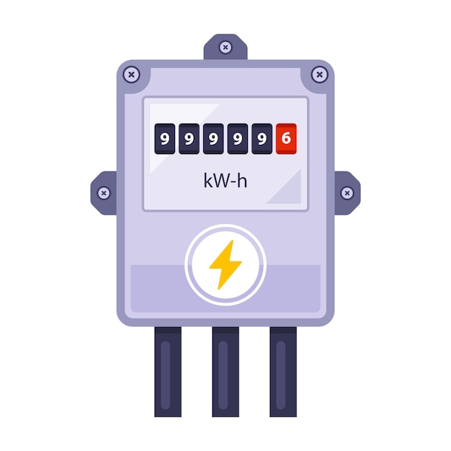
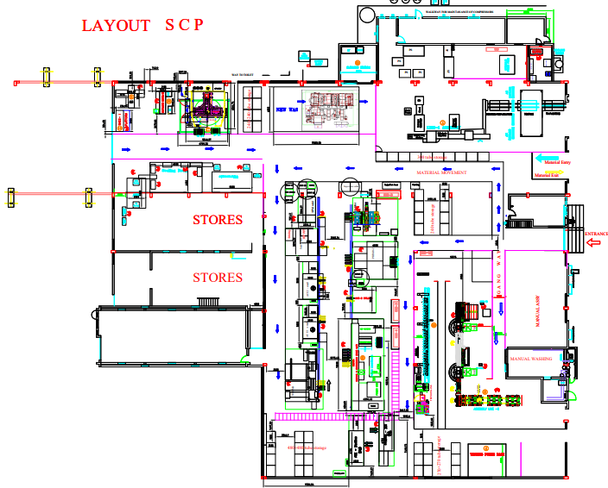
Current Energy Meter Connections
One energy meter is connected to multiple machines making it difficult to record energy consumption per product.

Slide 18
Proposed Solution : SUBMETERING
Submetering enables us to realize the energy consumption for different machines, enabling us to track the energy consumed per hydraulic cylinder.

Slide 19
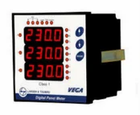
The energy meters that are already being used in the plant (Schneider-make. Model:_EM6400. Accuracy class-1.0) are capable of monitoring minimum/maximum energy with date/time stamping but cannot be used for data logging.
Advanced panel meters can be installed since they are capable of data logging and exporting the data through a USB port. They allow for remote data transmission to a central monitoring system or SCADA (Supervisory Control And Data Acquisition) system.
Shift supervisors should make a note of the energy consumption data daily to identify areas of improvement through daily observation.
PANEL METER
Notes:
Panel meters are economical solutions to record data and enable comprehensive monitoring.

Slide 20
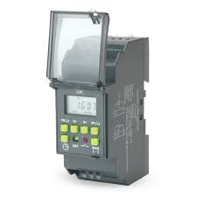
Other suggestions:
Machines not in use can be switched off during breaktime, since the only time they are turned off is when they require maintenance.
Programmable digital timer switches can be used to provide precise timing control over electronic circuits to switch off the machines when not in use.
IE 3 or IE 4 motors should be installed to get better energy efficiency.
DIGITAL TIMER SWITCH

Slide 21
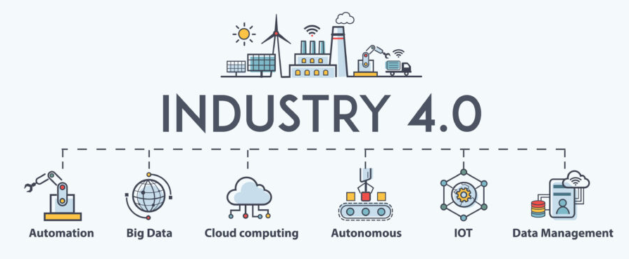
State of Art Methods to Monitor Energy
IIOT (Industrial Internet of Things)
It is the use of Internet of Things (IoT) technologies in industrial settings to enhance operations, efficiency, and productivity.
In a hydraulics plant, IIoT could involve connecting sensors, equipment, and systems to a network to collect and analyze data in real-time, enabling better decision-making and predictive maintenance.
IIOT systems can store historical data enabling models to learn from past trends and equipment behavior.
IIOT sensors can measure a wide range of parameters such as temperature, pressure, flow rate and vibration etc. which can allow us to identify complex relationships between variables using Machine Learning.
Notes:
As of now we weren’t able to monitor many variables to come up with a machine learning model, but the amount of variables we can measure using IIOT would definitely help us in building a model with quite an accuracy.

Slide 22
Thank You & Stay safe

